Slide 1
Robots – Theory

Slide 2
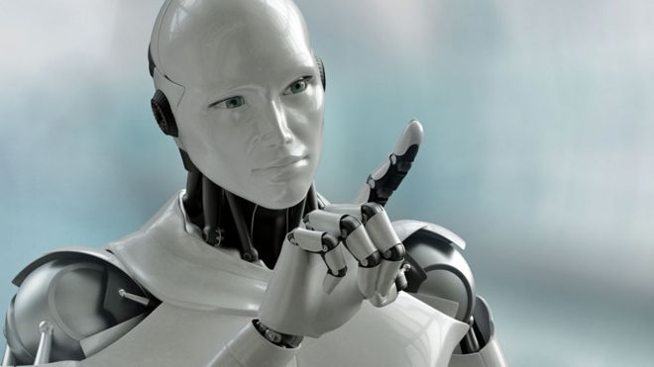
Introduction
Robots are machines that can be used to do jobs. Some robots can do work by themselves. Other robots must always have a person telling them what to do.

